Slide 1
Viruses and Worms

Slide 2
Malware
Malicious code often masquerades as good software or attaches itself to good software
Some malicious programs need host programs
  Trojan horses, logic bombs, viruses
Others can exist and propagate independently
  Worms, automated viruses
There are many infection vectors and propagation mechanisms

Slide 3
Trojan Horses
A trojan horse is malicious code hidden in an apparently useful host program
When the host program is executed, trojan does something harmful or unwanted
  User must be tricked into executing the host program
  In 1995, a program distributed as PKZ300B.EXE looked like a new version of PKZIP… When executed, it formatted your hard drive.
Trojans do not replicate
  This is the main difference from worms and viruses

Slide 4
Viruses
Virus propagates by infecting other programs
  Automatically creates copies of itself, but to propagate, a human has to run an infected program
    Self-propagating malicious programs are usually called worms
Viruses employ many propagation methods
  Insert a copy into every executable (.COM, .EXE)
  Insert a copy into boot sectors of disks
    “Stoned” virus infected PCs booted from infected floppies, stayed in memory and infected every floppy inserted into PC
  Infect TSR (terminate-and-stay-resident) routines
    By infecting a common OS routine, a virus can always stay in memory and infect all disks, executables, etc.

Slide 5
Viruses
Functioning programs
Virus

Slide 6
Virus Techniques
Stealth viruses
  Infect OS so that infected files appear normal to user
Macro viruses
  A macro is an executable program embedded in a word processing document (MS Word) or spreadsheet (Excel)
  When infected document is opened, virus copies itself into global macro file and makes itself auto-executing (e.g., gets invoked whenever any document is opened)
Polymorphic viruses
  Viruses that mutate and/or encrypt parts of their code with a randomly generated key

Slide 7
Evolution of Polymorphic Viruses
Anti-virus scanners detect viruses by looking for signatures (snippets of known virus code)
Encrypted viruses: virus consists of a constant decryptor, followed by the encrypted virus body
  Cascade (DOS), Mad (Win95), Zombie (Win95)
  Relatively easy to detect because decryptor is constant
Descriptor
Key
Encrypted Virus Body

Slide 8
Evolution of Polymorphic Viruses
Oligomorphic viruses: different versions of virus have different encryptions of the same body
  Small number of decryptors (96 for Memorial viruses); to detect, must understand how they are generated
Descriptor
Key
Encrypted Virus Body

Slide 9
Evolution of Polymorphic Viruses
Polymorphic viruses: constantly create new random encryptions of the same virus body
  Marburg (Win95), HPS (Win95), Coke (Win32)
  Virus must contain a polymorphic engine for creating new keys and new encryptions of its body
    Rather than use an explicit decryptor in each mutation, Crypto virus (Win32) decrypts its body by brute-force key search

Slide 10
Virus Detection by Emulation
Randomly generates a new key
and corresponding decryptor code
Decrypt and execute
Mutation A
Virus body
Mutation B
Mutation C
To detect an unknown mutation of a known virus ,
emulate CPU execution of until the current sequence of
instruction opcodes matches the known sequence for virus body

Slide 11
Anti-Virus Technologies
Simple anti-virus scanners
  Look for signatures (fragments of known viruses)
  Heuristics for recognizing code associated with viruses
    For example, polymorphic viruses often use decryption loops
  Integrity checking to find modified files
    Record file sizes, checksums, MACs (keyed hashes of contents)
Generic decryption and emulation scanners
  Goal: detect polymorphic viruses with known body
  Emulate CPU execution for a few hundred instructions, virus will eventually decrypt, can recognize known body
    Does not work very well against metamorphic viruses and viruses not located near beginning of infected executable

Slide 12
Defeating Anti-Virus Emulators
To detect polymorphic viruses, emulators execute suspect code for a little bit and look for opcode sequences of known virus bodies
Some viruses use random code block insertion or insert millions of NOPs at the entry point prior to the main virus body
  Emulator executes code for a while, does not see virus body and decides the code is benign… when main virus body is finally executed, virus propagates

Slide 13
Metamorphic Viruses
Obvious next step: mutate the virus body, too!
Virus can carry its source code (which deliberately contains some useless junk) and recompile itself
  Apparition virus (Win32)
  Virus first looks for an installed compiler
    Unix machines have C compilers installed by default
  Virus changes junk in its source and recompiles itself
    New binary mutation looks completely different!
Many macro and script viruses evolve and mutate their code
  Macros/scripts are usually interpreted, not compiled

Slide 14
Metamorphic Mutation Techniques
Same code, different register names
  Regswap (Win32)
Same code, different subroutine order
  BadBoy (DOS), Ghost (Win32)
  If n subroutines, then n! possible mutations
    8! = 40320, 10!=3628800
Decrypt virus body instruction by instruction, push instructions on stack, insert and remove jumps, rebuild body on stack
  Zmorph (Win95)
  Can be detected by emulation because the rebuilt body has a constant instruction sequence

Slide 15
Mutation Engines
Real Permutating Engine/RPME (introduced in Zperm virus), ADMutate, many others
Employ a large set of obfuscating techniques
  Instructions are reordered, branch conditions reversed
  Jumps and NOPs inserted in random places
  Garbage opcodes inserted in unreachable code areas
  Instruction sequences replaced with other instructions that have the same effect, but different opcodes
    Mutate SUB EAX, EAX into XOR EAX, EAX or
    PUSH EBP; MOV EBP, ESP into PUSH EBP; PUSH ESP; POP EBP
There is no constant, recognizable virus body!

Slide 16
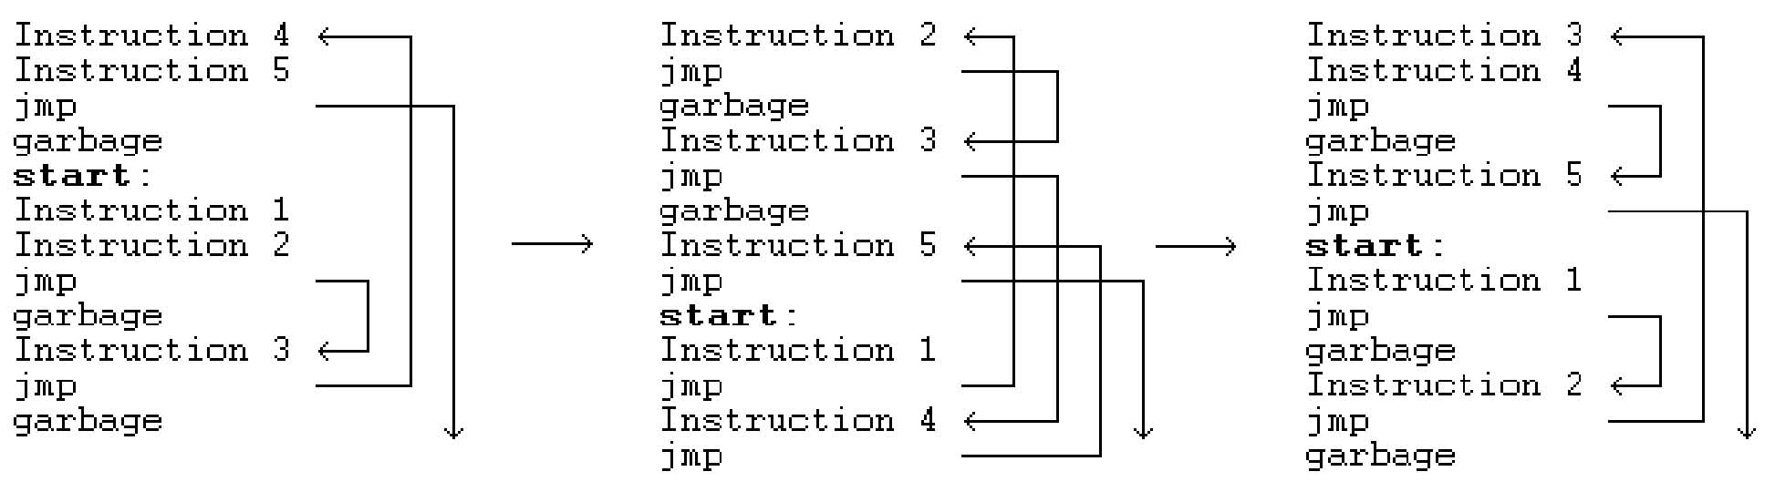
Example of Zperm Mutation

Slide 17
Putting It All Together: Zmist
Zmist was designed in 2001 by Russian virus writer Z0mbie of “Total Zombification” fame
New technique: code integration
  Virus merges itself into the instruction flow of its host
  “Islands” of code are integrated
  into random locations in the host
  program and linked by jumps
  When/if virus code is run, it infects
  every available portable executable
    Randomly inserted virus entry point
    may not be reached in a particular execution

Slide 18
MISTFALL Disassembly Engine
To integrate itself into host ’s instruction flow, virus must disassemble and rebuild host binary
  See overview at http://vx.netlux.org/lib/vzo21.html
This is very tricky
  Addresses are based on offsets, which must be recomputed when new instructions are inserted
  Virus must perform complete instruction-by-instruction disassembly and re-generation of the host binary
    This is an iterative process: rebuild with new addresses, see if branch destinations changed, then rebuild again
    This requires 32MB of RAM and explicit section names (DATA, CODE, etc.) in the host binary – doesn’t work with every file

Slide 19
Simplified Zmist Infection Process
Randomly insert
indirect call OR jump
to decryptor’s entry
point OR rely on
instruction flow to
reach it
Pick a Portable
Executable binary
< 448Kb in size
Decryptor must
restore host’s
registers to
preserve host’s
functionality
Disassemble, insert space for new
code blocks, generate new binary
Insert mutated virus body
Split into jump-linked “islands”
Mutate opcodes (XOR↔SUB, OR↔TEST)
Swap register moves and PUSH/POP, etc.
Encrypt virus body by
XOR (ADD, SUB) with a
randomly generated key,
insert mutated decryptor
Insert random garbage
instructions using
Executable Trash Generator

Slide 20
Morris Worm Redux
1988: No malicious payload, but bogged down infected machines by uncontrolled spawning
  Infected 10% of all Internet hosts at the time
Multiple propagation vectors
  Remote execution using rsh and cracked passwords
    Tried to crack passwords using small dictionary and publicly readable password file; targeted hosts from /etc/hosts.equiv
  Buffer overflow in fingerd on VAX
    Standard stack smashing exploit
  DEBUG command in Sendmail
    In early Sendmail versions, possible to execute a command on a remote machine by sending an SMTP (mail transfer) message
Dictionary attack
Buffer overflow attack

Slide 21
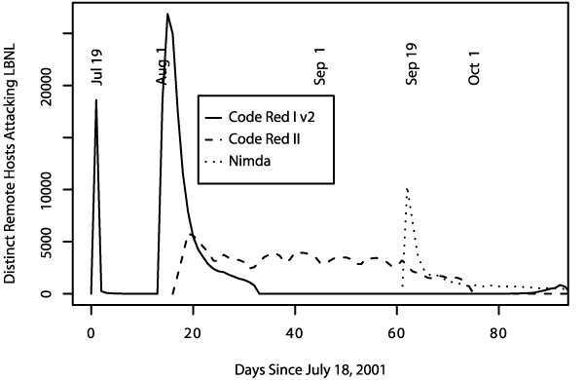
Summer of 2001
Three major worm
outbreaks

Slide 22
Code Red I
July 13, 2001: First worm of the modern era
Exploited buffer overflow in Microsoft’s Internet Information Server (IIS)
1st through 20th of each month: spread
  Find new targets by random scan of IP address space
    Spawn 99 threads to generate addresses and look for IIS
  Creator forgot to seed the random number generator, and every copy scanned the same set of addresses
21st through the end of each month: attack
  Deface websites with “HELLO! Welcome to http://www.worm.com! Hacked by Chinese!”

Slide 23
Usurped Exception Handling In IIS
Overflow in a rarely used URL decoding routine
  A malformed URL is supplied to vulnerable routine…
  … another routine notices that stack has been smashed and raises an exception. Exception handler is invoked…
  … the pointer to exception handler is located on stack. It has been overwritten to point to a certain instruction inside the routine that noticed the overflow…
  … that instruction is CALL EBX. At that moment, EBX is pointing into the overwritten buffer…
  … the buffer contains the code that finds the worm’s main body on the heap and executes it!

Slide 24
Code Red I v2
July 19, 2001: Same codebase as Code Red I, but fixed the bug in random IP address generation
  Compromised all vulnerable IIS servers on the Internet
  Large vulnerable population meant fast worm spread
    Scanned address space grew exponentially
    350,000 hosts infected in 14 hours!!
Payload: distributed packet flooding (denial of service) attack on www.whitehouse.gov
  Coding bug causes it to die on the 20th of each month… but if victim’s clock is wrong, resurrects on the 1st!

Slide 25
Code Red II
August 4, 2001: Same IIS vulnerability, completely different code, kills Code Red I
  Known as “Code Red II” because of comment in code
  Worked only on Windows 2000, crashed NT
Scanning algorithm preferred nearby addresses
  Chose addresses from same class A with probability ½, same class B with probability 3/8, and randomly from the entire Internet with probability 1/8
Payload: installed root backdoor in IIS servers for unrestricted remote access
Died by design on October 1, 2001

Slide 26
Nimda
September 18, 2001: Multi-modal worm using several propagation vectors
  Exploit same IIS buffer overflow as Code Red I and II
  Bulk-email itself as an attachment to email addresses harvested from infected machines
  Copy itself across open network shares
  Add exploit code to Web pages on compromised sites to infect visiting browsers
  Scan for backdoors left by Code Red II
Payload: turned-off code deleting all data on hard drives of infected machines

Slide 27
Signature-Based Defenses
Nimda leaped firewalls!
Many firewalls pass mail untouched, relying on mail servers to filter out infections
  Most filters simply scan attachments for signatures (code snippets) of known viruses and worms
Nimda was a brand-new infection with unknown signature, and scanners could not detect it
Big challenge: detection of zero-day attacks
  When a worm first appears in the wild, signature is not extracted until minutes or hours later

Slide 28
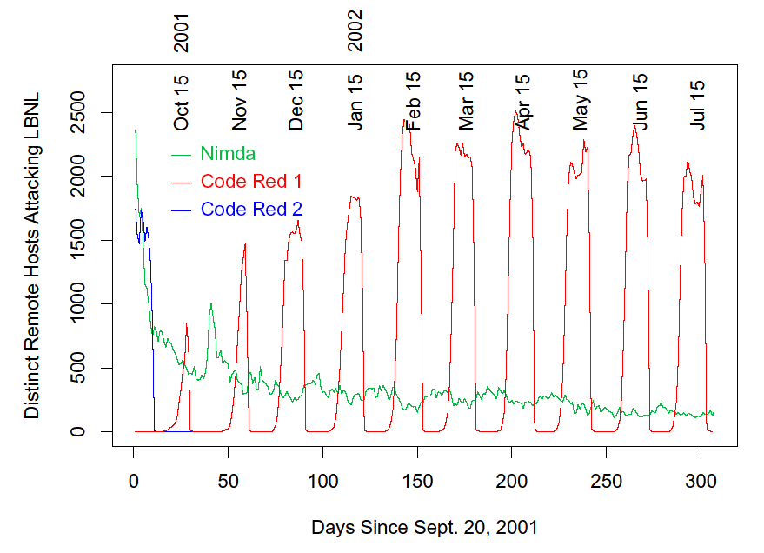
Code Red I and II
With its predator gone, Code Red I comes back, still exhibiting monthly pattern
Code Red II dies off as programmed

Slide 29
Slammer (Sapphire) Worm
January 24/25, 2003: UDP worm exploiting buffer overflow in Microsoft’s SQL Server
  Overflow was already known and patched by Microsoft… but not everybody installed the patch
Entire code fits into a single 404-byte UDP packet
  Worm binary followed by overflow pointer back to itself
Classic buffer overflow combined with random scanning: once control is passed to worm code, it randomly generates IP addresses and attempts to send a copy of itself to port 1434
  MS-SQL listens at port 1434

Slide 30
Slammer Propagation
Scan rate of 55,000,000 addresses per second
  Scan rate = rate at which worm generates IP addresses of potential targets
  Up to 30,000 single-packet worm copies per second
Initial infection was doubling in 8.5 seconds
  Doubling time of Code Red was 37 minutes
Worm-generated packets saturated carrying capacity of the Internet in 10 minutes
  75,000 SQL servers compromised
  And that’s in spite of broken pseudo-random number generator used for IP address generation

Slide 31
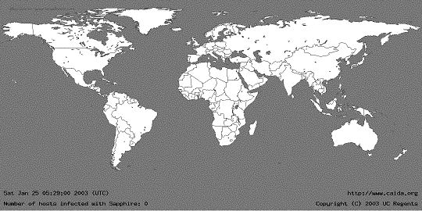
05:29:00 UTC, January 25, 2003
[from Moore et al. “The Spread of the Sapphire/Slammer Worm”]

Slide 32
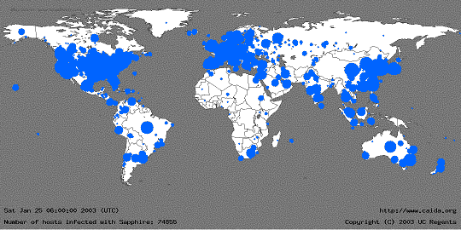
30 Minutes Later
[from Moore et al. “The Spread of the Sapphire/Slammer Worm”]
Size of circles is logarithmic in
the number of infected machines

Slide 33
Slammer Impact
$1.25 Billion of damage
Temporarily knocked out many elements of critical infrastructure
  Bank of America ATM network
  Entire cell phone network in South Korea
  Five root DNS servers
  Continental Airlines’ ticket processing software
The worm did not even have malicious payload… simply bandwidth exhaustion on the network and resource exhaustion on infected machines

Slide 34
Secret of Slammer’s Speed
Old-style worms (Code Red) spawn a new thread which tries to establish a TCP connection and, if successful, send a copy of itself over TCP
  Limited by latency of the network
Slammer was a connectionless UDP worm
  No connection establishment, simply send 404-byte UDP packet to randomly generated IP addresses
  Limited only by bandwidth of the network
A TCP worm can scan even faster
  Dump millions of 40-byte TCP-SYN packets into link layer, send worm copy only if SYN-ACK comes back

Slide 35
Blaster and Welchia/Nachia
August 11, 2003: Scanning worm exploiting RPC service in Microsoft Windows XP and 2000
  First address at random, then sequential upward scan
    Easy to detect, yet propagated widely and leaped firewalls
Payload: denial of service against MS Windows Update + installing remotely accessible backdoor
Welchia/Nachia was intended as a counter-worm
  Random-start sequential scan, use ICMP to determine if address is live, then copy itself over, patch RPC vulnerability, remove Blaster if found
  Did more damage by flooding networks with traffic

Slide 36
How to Build a Super-Worm?
Objective: Warhol worm
  Worm that reaches saturation (infection of all potentially vulnerable targets) in 15 minutes
  Faster than any possible human-mediated response
Previous worms suffered from suboptimal design
  Slammer copies ended competing with themselves for bandwidth
    30% of randomly generated IP addresses are unused
    This causes routing table misses, ICMP (router error) traffic
  Broken address generation algorithms
  Buggy payloads (premature death, failed DDoS, etc.)

Slide 37
Better Target Address Generation
Pre-compute hit-list of vulnerable hosts
  Very slow, stealthy scan for known vulnerabilities over several months prior to worm release
    To cover your tracks, do it from hacked “zombie” machines
  Web-crawling spiders
  Listen for responses to other attacks
    E.g., every IIS infected with Code Red announced its presence by dumping large amounts of traffic to random addresses
Even imperfect hit-list will greatly speed up initial infection (slowest part of worm propagation)
  Start with a single host; every time the worm divides, it “outsources” half of its hit-list to the new copy

Slide 38
Coordinated Scanning
Random address generation is inefficient
  Many addresses are probed multiple times, worm copies flood the bandwidth
Permutation scan: each copy starts to scan from a random point in IP address space; if encounters another copy, randomly picks another point
  Worm needs to recognize its own presence on the target machine
Divide-and-conquer: split target address space in half each time a new copy is created
  Probably can infect 1,000,000 hosts in 2 seconds

Slide 39
Exploit Existing Networks
Use network topology
  Morris worm looked for new targets in hosts.equiv
  Peer-to-peer networks are perfect targets
    Instead of generating random addresses, just spread to peers
Get initial hit-list from meta-servers
  Use online directories to find potential victims
  Paxson’s example: Google for “powered by phpbb” to find websites running PHP
Piggyback on existing network traffic
  E.g., worm inserts itself into Kazaa or BitTorrent traffic
  Virtually undetectable (no unusual network activity!)

